Slide 1

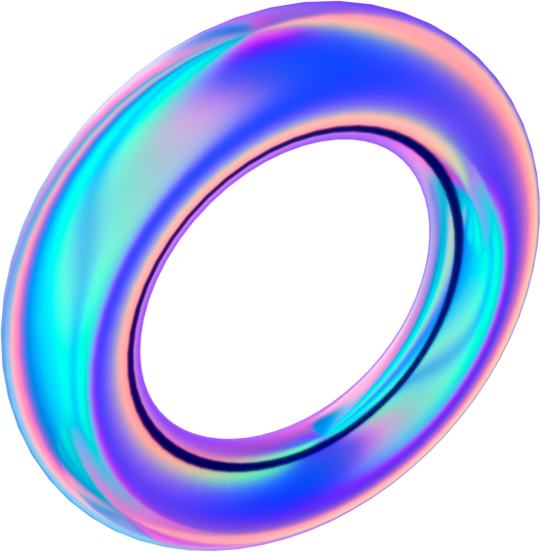


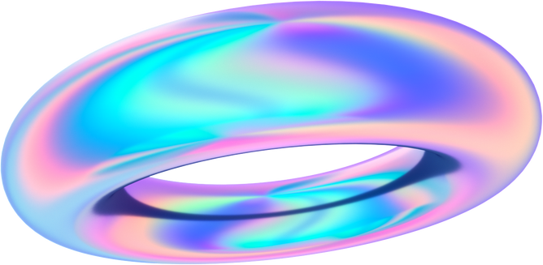
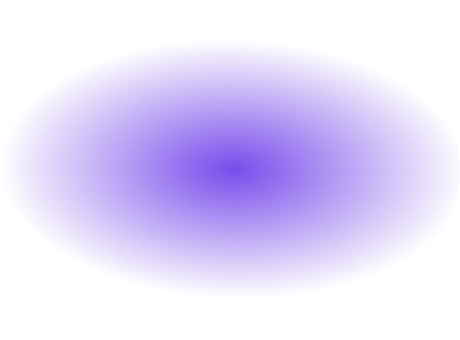

TensorFlow
Presentation

Slide 2
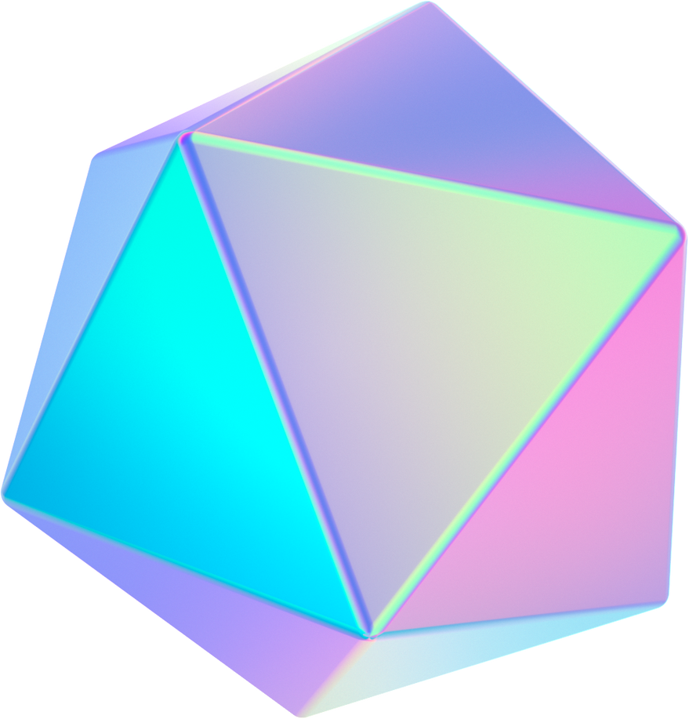

What is TensorFlow ?
TensorFlow is an open-source library for AI.
Has comprehensive ecosystem (variety of tools).
Provide powerful visualization tools.
Developed by Google Brain Team.
Provides optimized-performance.

Slide 3


Developments of TensorFlow
TensorFlow focuses on enhancing ease of use, efficiency, and mobile deployment options.
TensorFlow 2.0 added aggressive execution and a more simplified API.

Slide 4
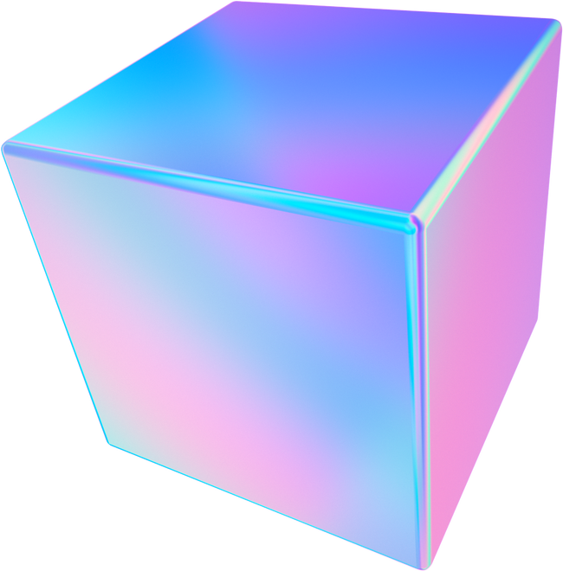
Applications of TensorFlow
Voice recognition.
Image recognition.
Natural Language Processing
Sentiment analysis.
Deep neural network.

Slide 5
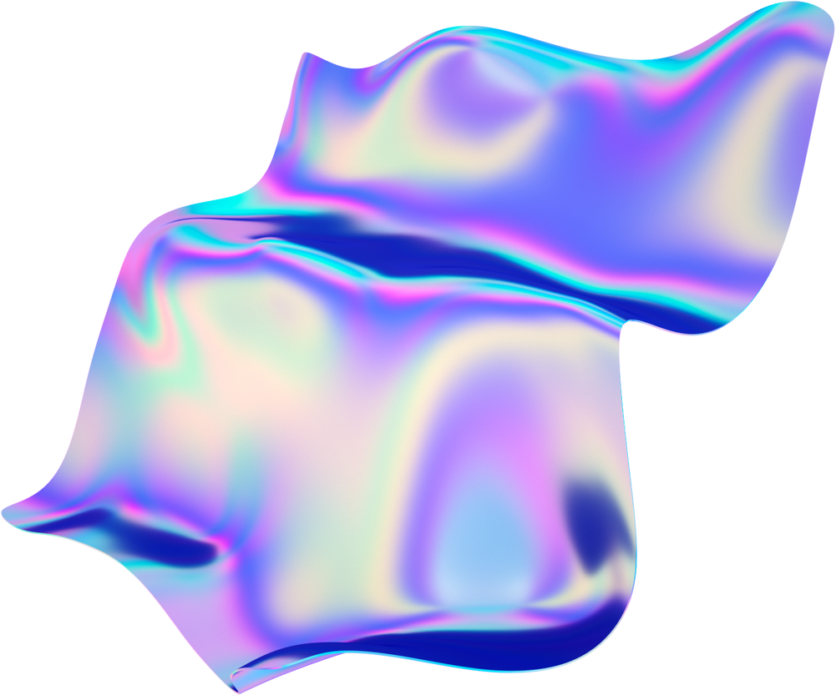
Comparison
TensorFlow
PyTorch
CNTK
Open Source
Strength : Comprehensive ecosystem.
Weaknesses : Can be complicated for simple tasks.
Open Source
Strength : Usability
Weaknesses : Much effort for deployment.
Open Source
Strength : Great performance
Weaknesses : Documentation can be challenging

Slide 6
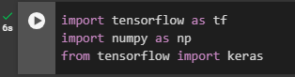
Experiment in Google Colab
In our experiment we will be providing two datasets to the model in order to make it learn the rule or the relation between the two datasets.
Step 1 : importing libraries
our libraries in our case it’s TensorFlow and NumPy and we will be using Keras from TensorFlow
Step 2 : Build the model
In this step we will build this model using Keras sequential class to define the network as sequence of layers.

Slide 7
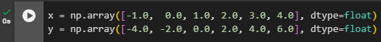
Experiment in Google Colab
Step 3: Compile the neural network
Now we will be compiling the neural network, we will have to specify new functions, loss function and optimizer function to make another guess based on how the loss function went, optimizer function will try to minimize the loss function by giving improved guesses.
Step 4: Provide the datasets
we provided 2 datasets X and Y that the relation between them is
Y = (2X-2) and make the model guess the relation and learn it between X and Y.

Slide 8

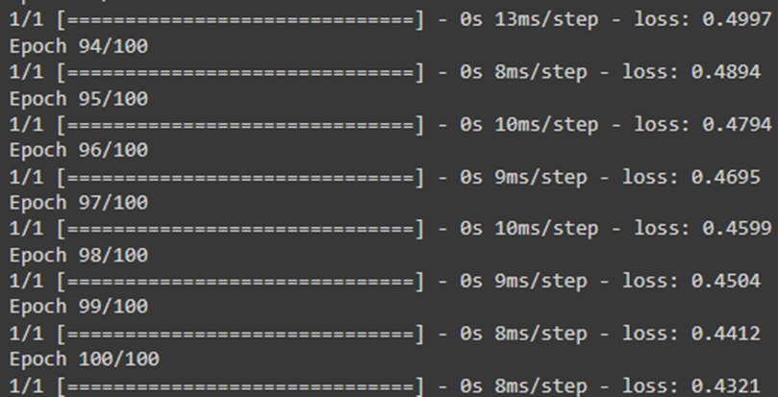
Experiment in Google Colab
Step 5: Train model
Now we will train our model with model.fit as we will see the loss function of our guess measure weather is it good or bad by the value and use optimizer to do improved guesses, epochs is the number of times the we will make our model train.
This is the result of model fit with 100 epochs and loss function of 0.4321

Slide 9
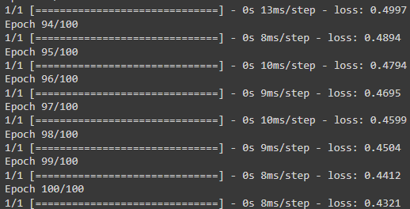
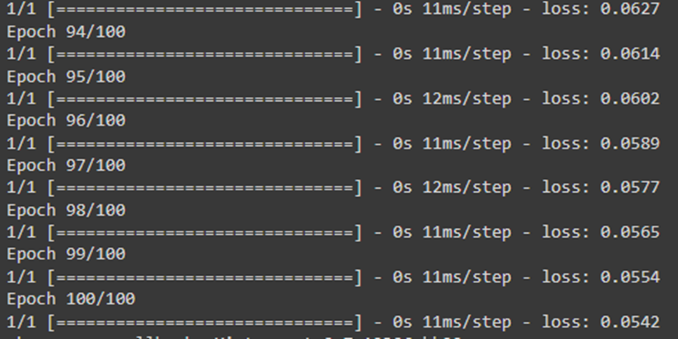
Experiment in Google Colab
As you can see we trained our model using 100 epochs our loss function is 0.4321 it is accepted value but what if we retrained or fit our model again using 100 epochs will it give the same loss function?
As you can see it is different than our first fit.

Slide 10
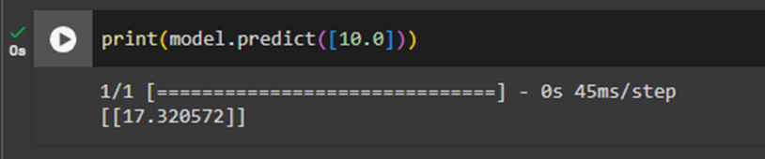
Experiment in Google Colab
Step 6: Model predict
we will be making our model to predict Y as X is provided to the model and the relationship between them is (2X-2) and we used model.fit to make the model learn it, lets give the model a value like 10 we will give it as 10.0 for float but will it give us (2(10)-2) as 18?
The model predicted 17.3 not 18, very close that is because we had loss function of 0.0542.

Slide 11
Questions
What does optimizer do?
Does high number of epochs means better loss functions?
What causes overfitting?
How to prevent overfitting?
How to measure how good the current guess is?

Slide 12

Represented By
Mohammed Aljalajil 442101136
Abdulaziz Alshaalan 441170125
Abdulelah Alhadyah 441102210
Abdulaziz Alhajri 441102528
ِAbdullah Ashalan 439101546
Thank You!

